Slide 1

Sixth Form Induction
Tenacity…
What TENACITY looks like at Sixth Form.
OUR CHRIST VALUES IN SIXTH FORM

Slide 2
A big part of remaining TENACIOUS at Sixth Form is having a goal in mind. Watch the video below to see what that means for a Sixth Form student…
Go to this link: https://www.netsixthform.co.uk/resources/view/week-3-video-having-a-goal-that-drives-you-year-11-transition-material-1
Watch the video ‘Vision: Having a Goal that Drives You’.
A video for you to watch first…
The more you know where you’re going, the more you’ll STRIVE to get there! THAT’S TENACITY!
Notes:
Section 1: 2 minute starter

Slide 3


Goals make us more TENACIOUS

Slide 4

Goals make us more TENACIOUS

Slide 5
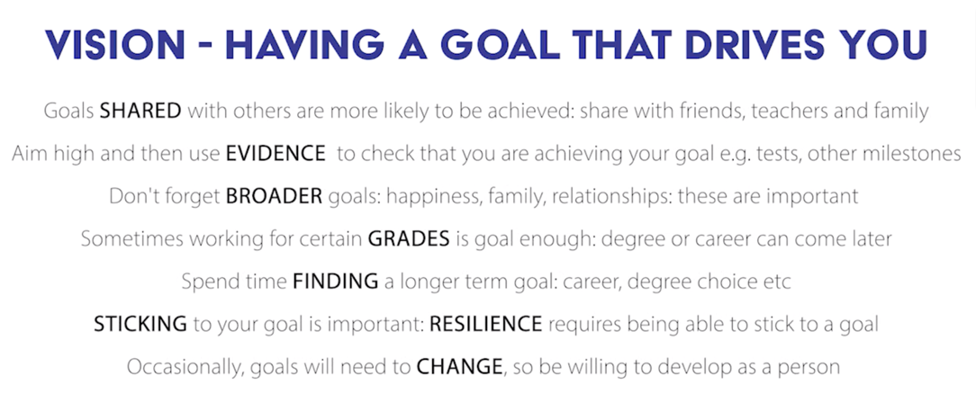
Goals make us more TENACIOUS

Slide 6

TASK: Use the prompts on the following slides to begin researching a potential route for you after Sixth Form. If you have no idea where to start, the Career Planner on the next slide will be really useful, as will the UCAS Career quiz! Sign up/ click on and have a go!

Slide 7



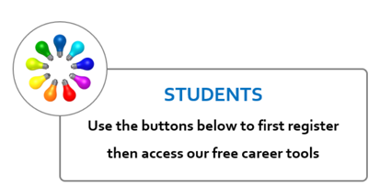
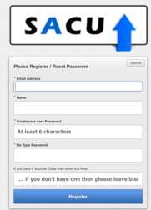
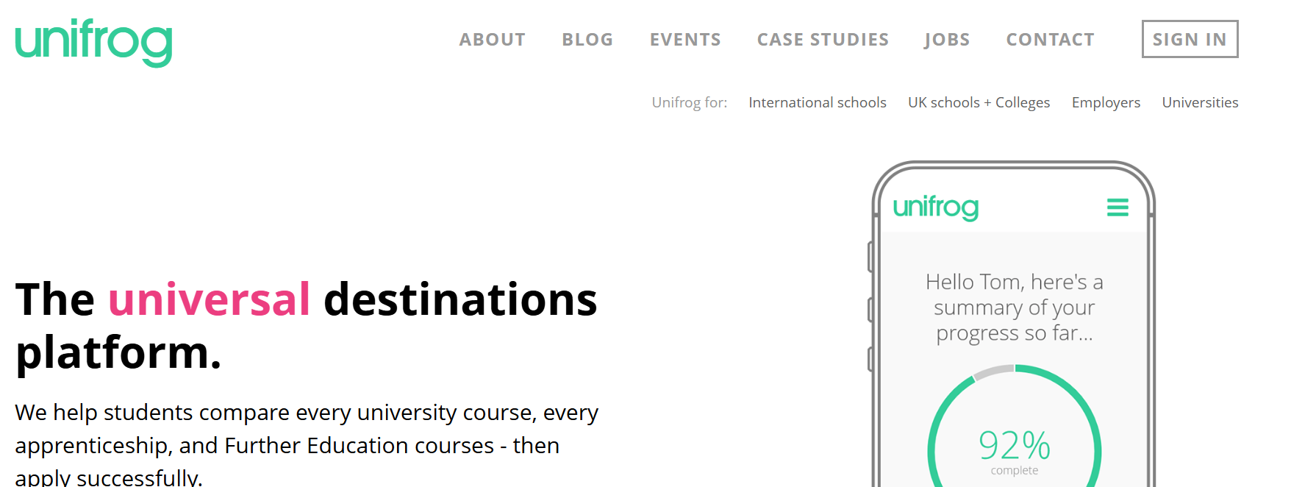
Do your research… helpful CAREER sites
https://youtu.be/TMQG4ZmDU5Y
Goals make us more TENACIOUS
https://sacu-student.com/?page_id=2760
This is the platform we use to track anything related to your future plans, from work experience to study skills to university choices. You’ll ‘on-boarded’ and given a login when you join us.
https://www.prospects.ac.uk/
https://www.unifrog.org/

Slide 8

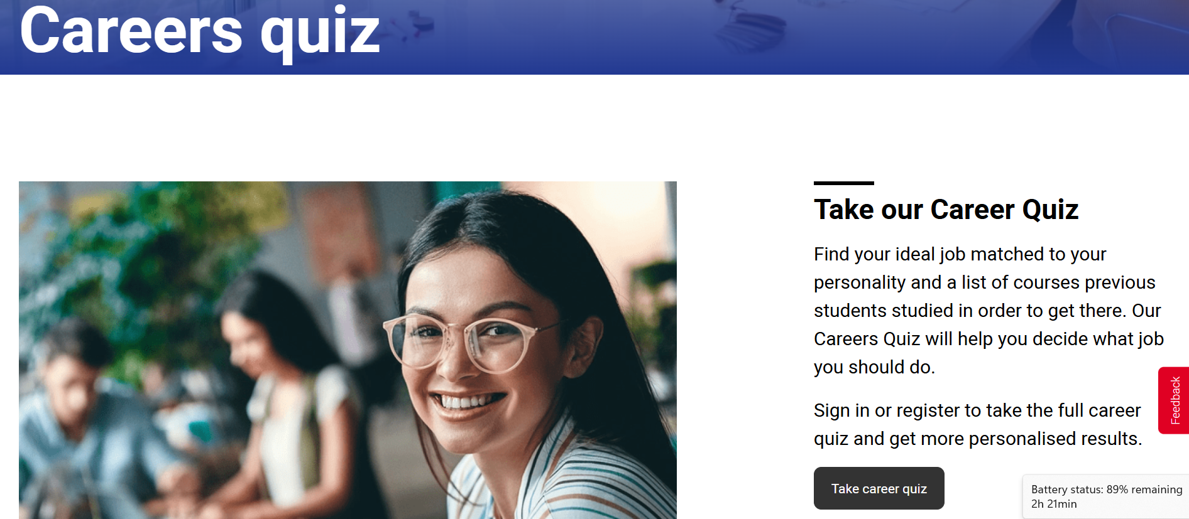
Take the UCAS careers quiz to see what you should be doing in the future!
https://www.ucas.com/careers-quiz
Goals make us more TENACIOUS

Slide 9

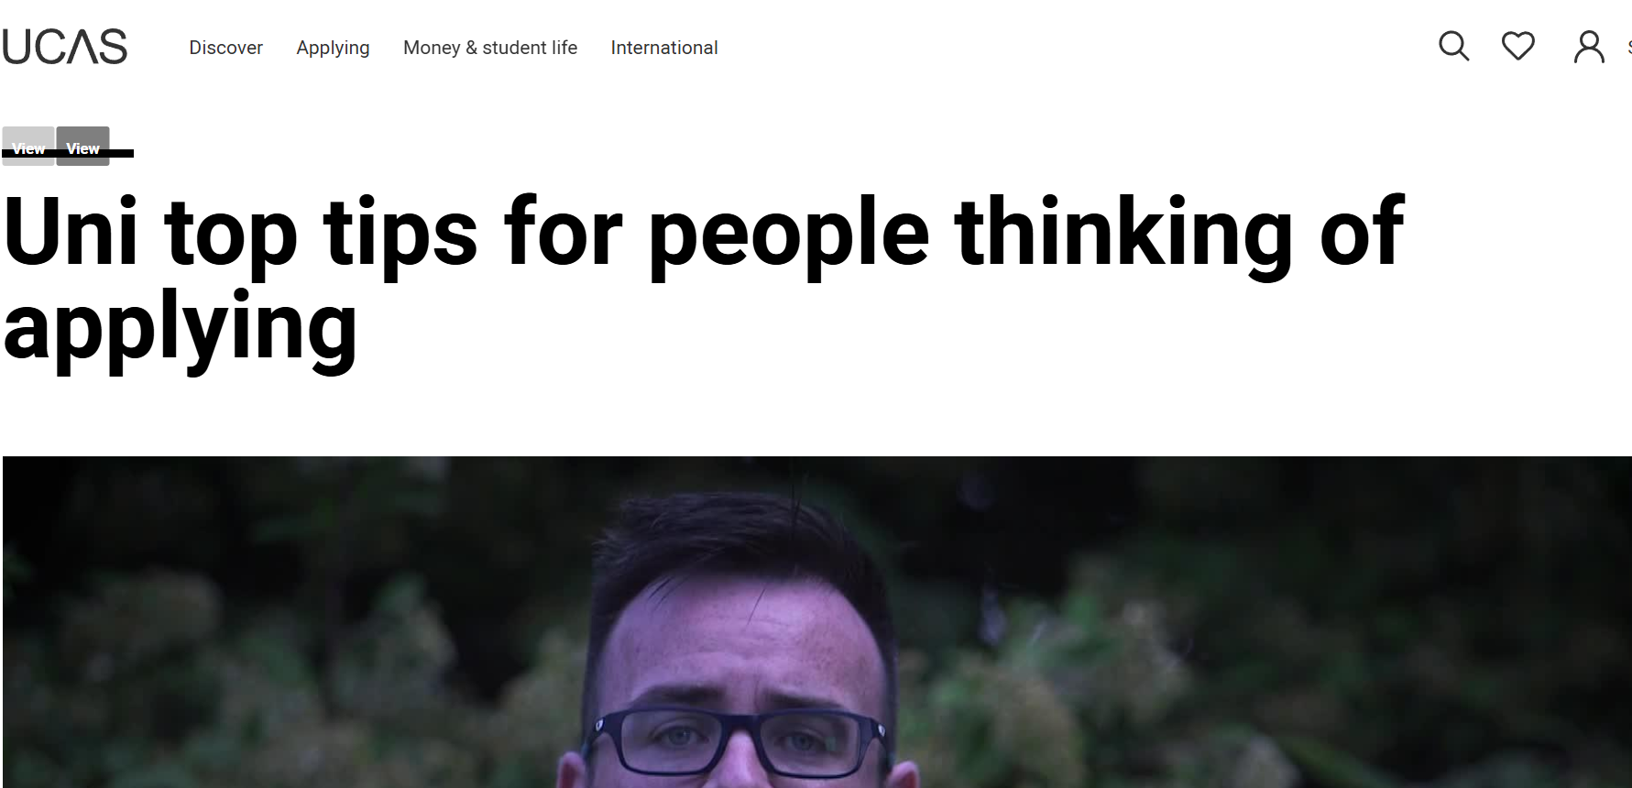
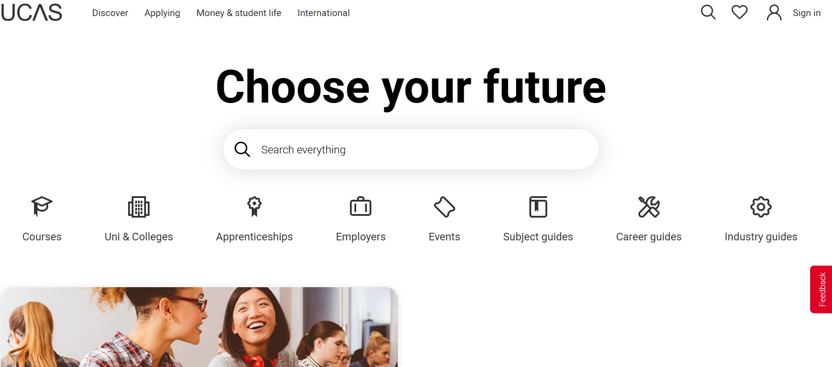

Do your research… helpful university sites
Goals make us more TENACIOUS
https://www.ucas.com/media/189221
https://www.ucas.com/

Slide 10

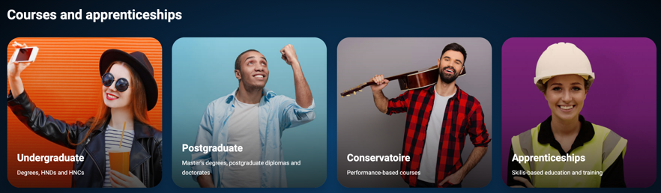

Do your research… helpful APPRENTICESHIPS
Goals make us more TENACIOUS
https://www.ucas.com/

Slide 11
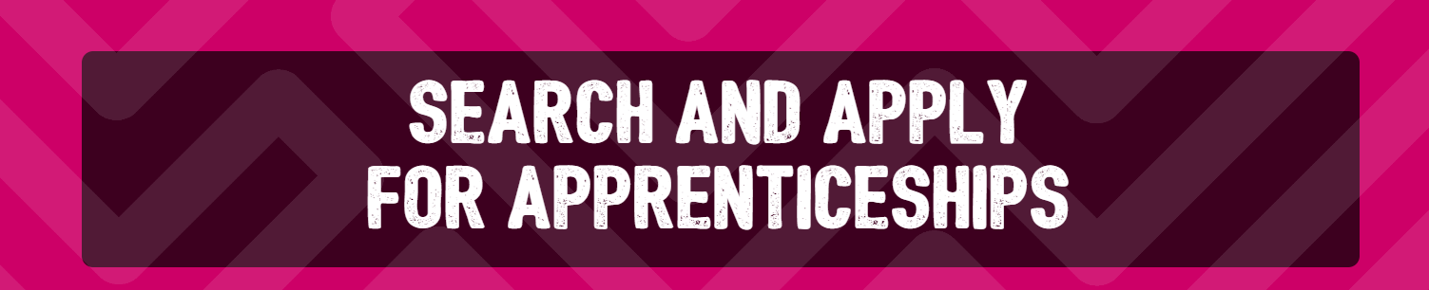



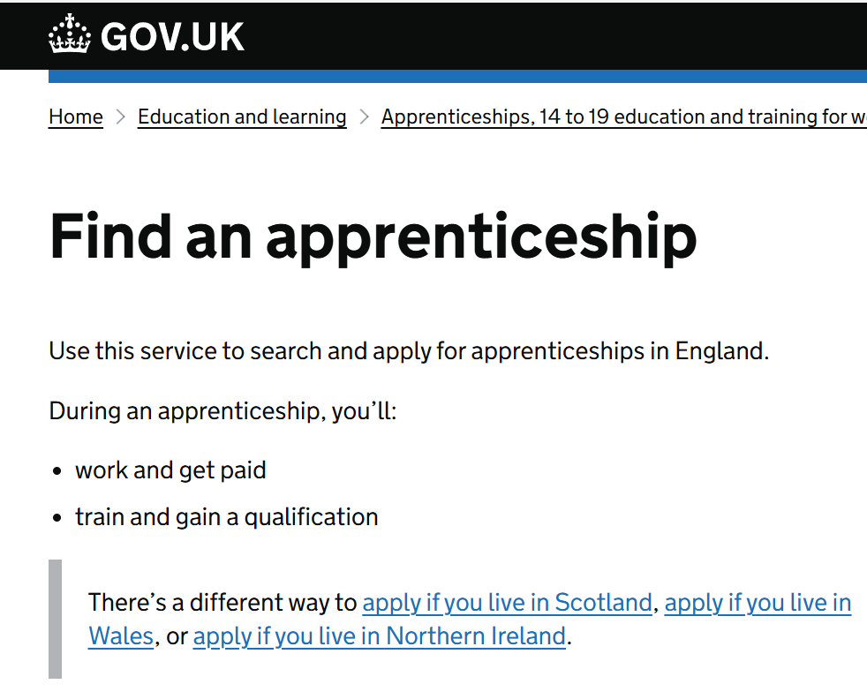
Do your research… helpful APPRENTICESHIPS and other useful sites.
Open the links for each image
https://www.amazingapprenticeships.com/search-and-apply/
Goals make us more TENACIOUS
https://www.pwc.co.uk/careers/student-careers/school-careers.html?gclid=Cj0KCQjwutaCBhDfARIsAJHWnHuRkPdxQhsFZF8amoe2E0FNdRZLmxhCW5SZJEhPpdyoRPhDNeLv3QUaAtb-EALw_wcB#/
Check out a company web site about their apprenticeships…you might need to go to individual companies to learn about apprenticeships…a bit like applying for a job. This one is PwC
https://www.gov.uk/apply-apprenticeship

Slide 12

Your goal – this will encourage you to be TENACIOUS and keep striving for what you want!
Having researched a possible goal, write down:
Your goal ……
GCSEs needed?
A-Levels or equivalent needed?
Any skills / experiences ……
Other ……
Goals make us more TENACIOUS

